Slide 1
Syncbox fırmware
Fırmware for xray machıenes

Slide 2
content
What is the target device?
What are available solutions?
What are their problems?
What we have done?
Future?

Slide 3
Our X-Ray machıne

Slide 4
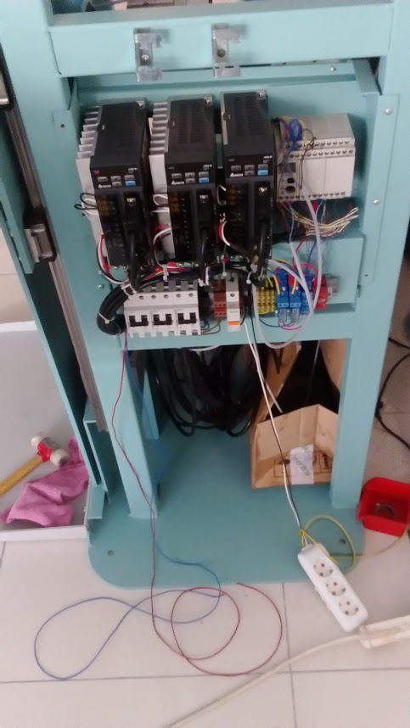
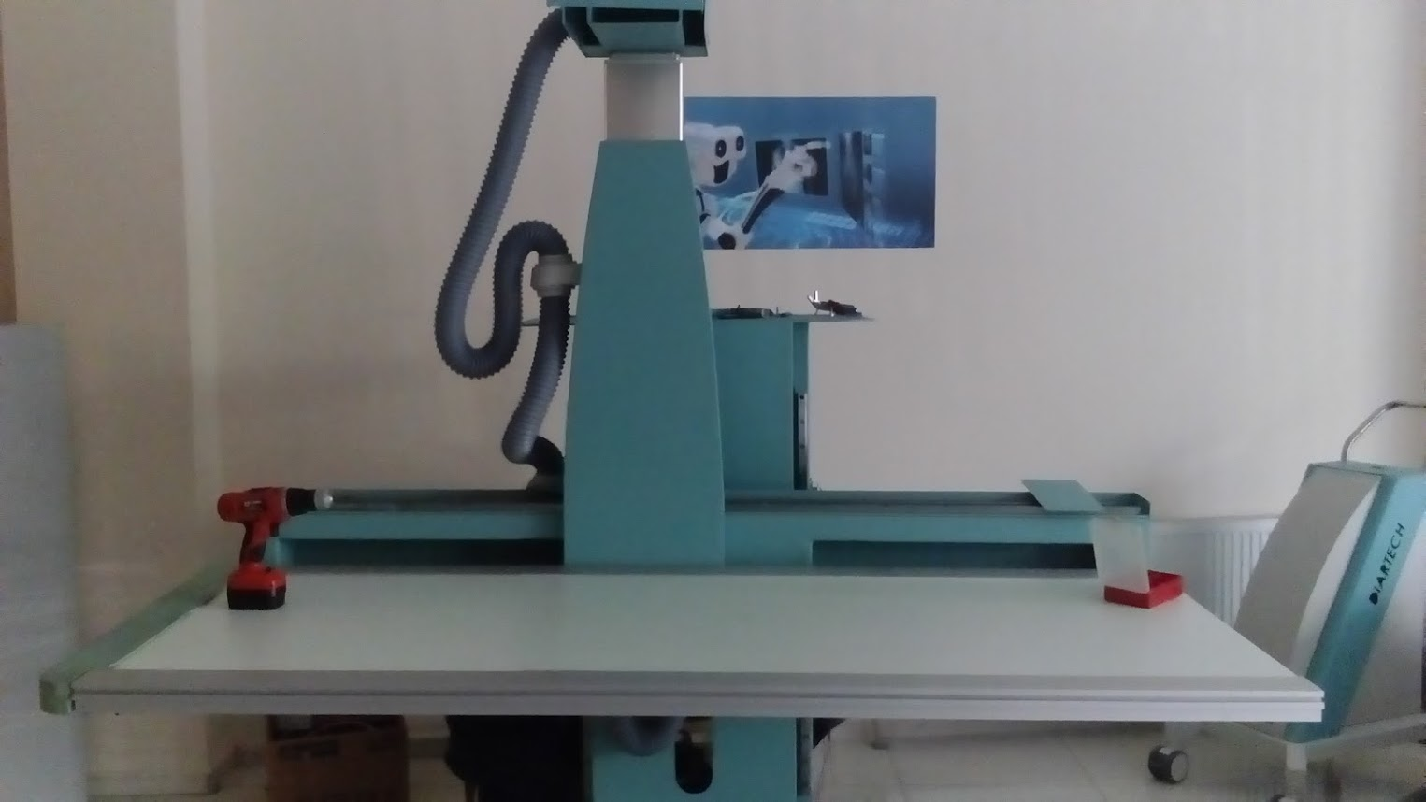
Our X-Ray machınes

Slide 5
Sımılar machınes

Slide 6
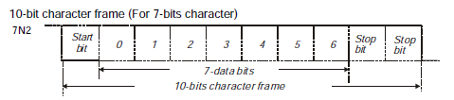
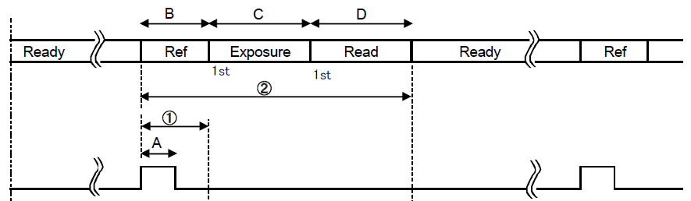




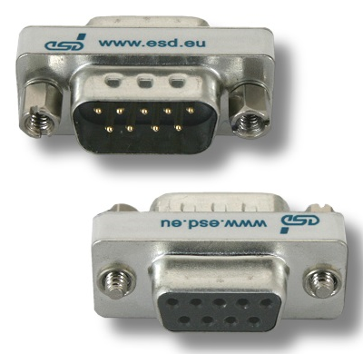
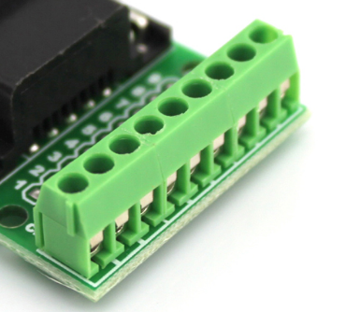
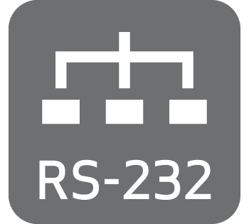


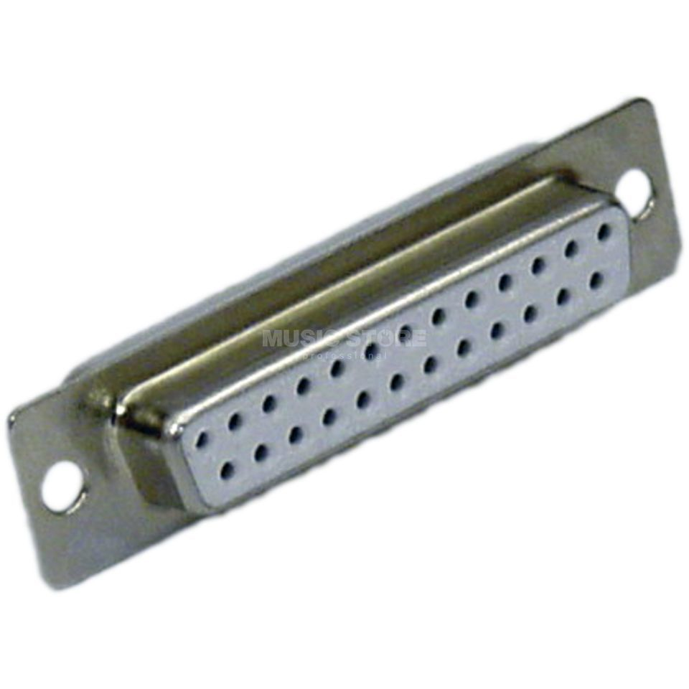
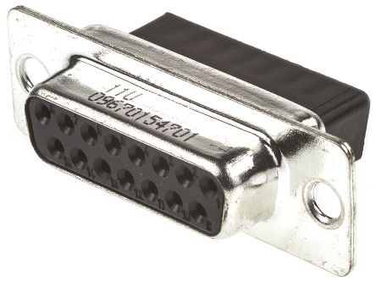
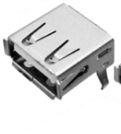

General problems
Signal Types
Comm. Prot.
Connector Types

Slide 7
HISTORY The killer machine therac-25

Slide 8



Solutıon
Unified Controlling & Synchronization Box
«SYNCBOX»

Slide 9
Syncbox fırmware approches
Adhoc
RTOS

Slide 10
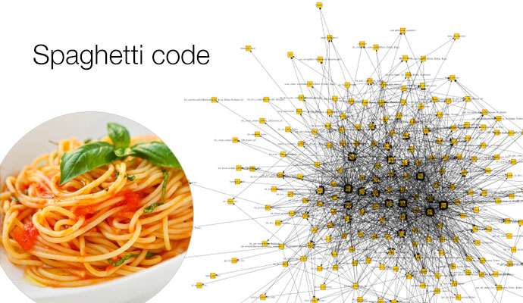
Adhoc solutıonS!

Slide 11




Real Tıme Operatıng System (RTOS)
http://wiki.pic24.ru/doku.php/en/tnkernel/ref/intro

Slide 12
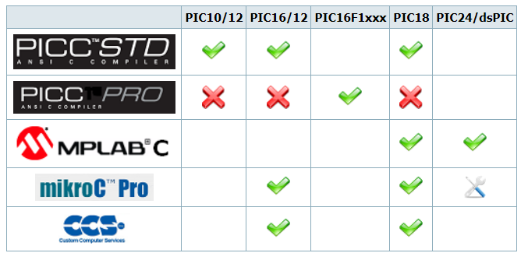

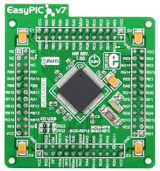
Why we dıd not use one?
IN RTOS WORLD: BOTH
COMPILER & uController are important

Slide 13
OUR APPROACH
Instrument
Application
Detector
API
Workstation
API
Actuator
API
API
Generator
API
Xray Package Ordering & Signal Transmitting Kernel
«xPOST»
XPOST KERNEL

Slide 14
xPOst aım #1
Generator
Actuator
Detector
Prioritarize Devices

Slide 15

xPOst aım #2
Order packages for each and in between devices

Slide 16
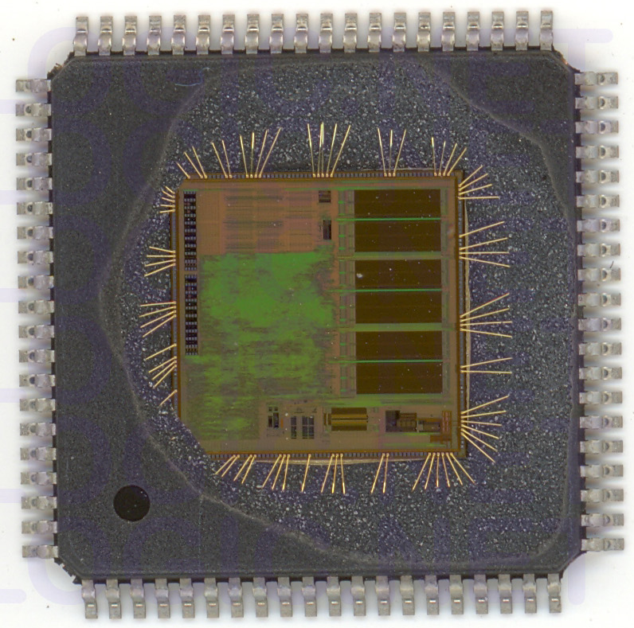
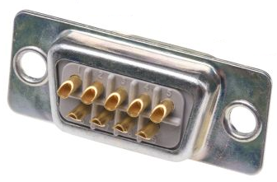
Xpost aım #3
Module
Abstract pin map for APIs

Slide 17
Insight xPost
API
Direct
Send
Buffered
Send
Send
Buffer
Receive
Buffer
Device

Slide 18
Buffer design
1
2
3
…
n

Slide 19
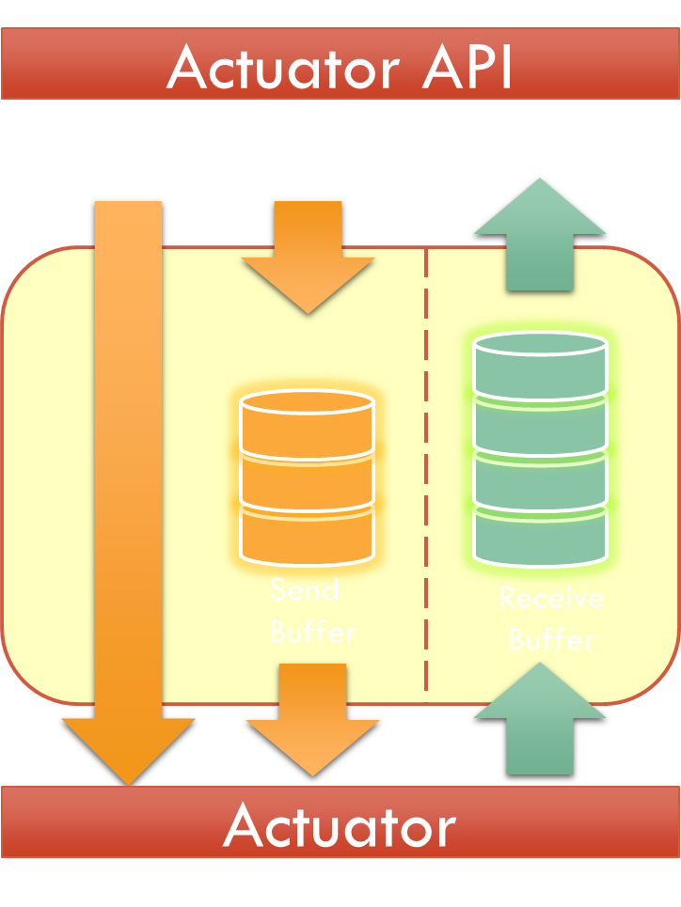


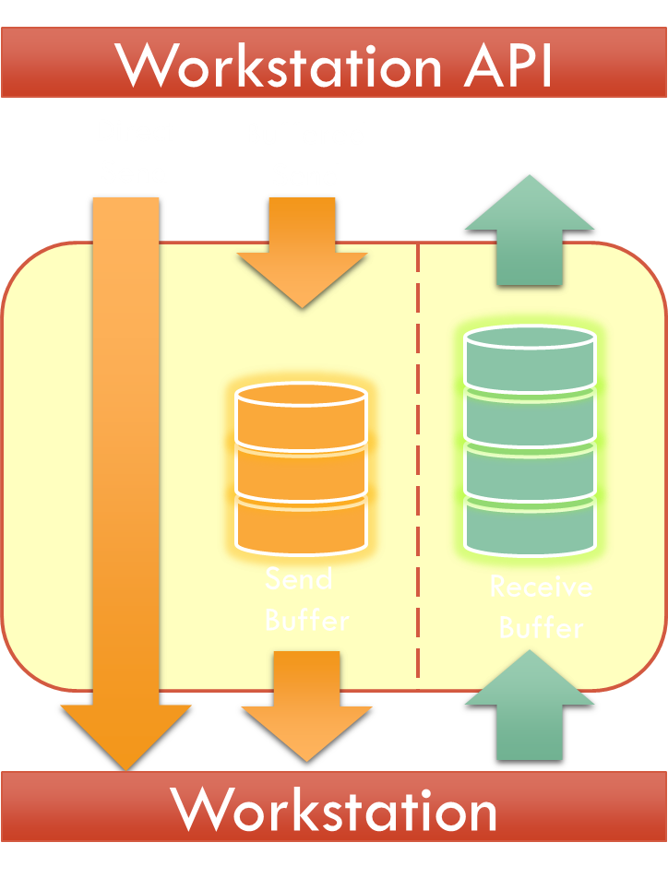
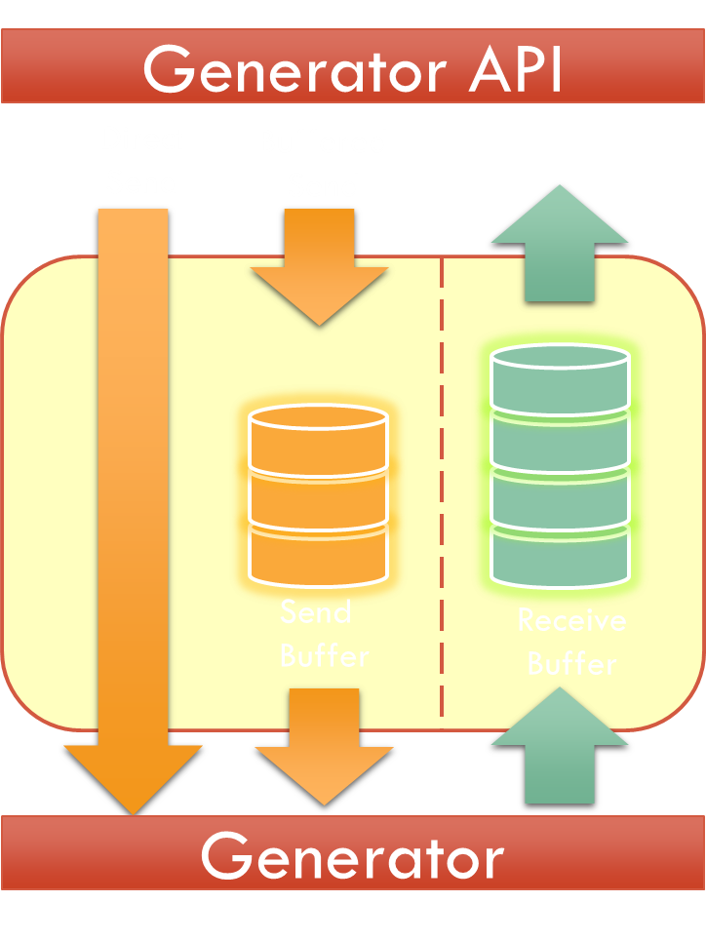


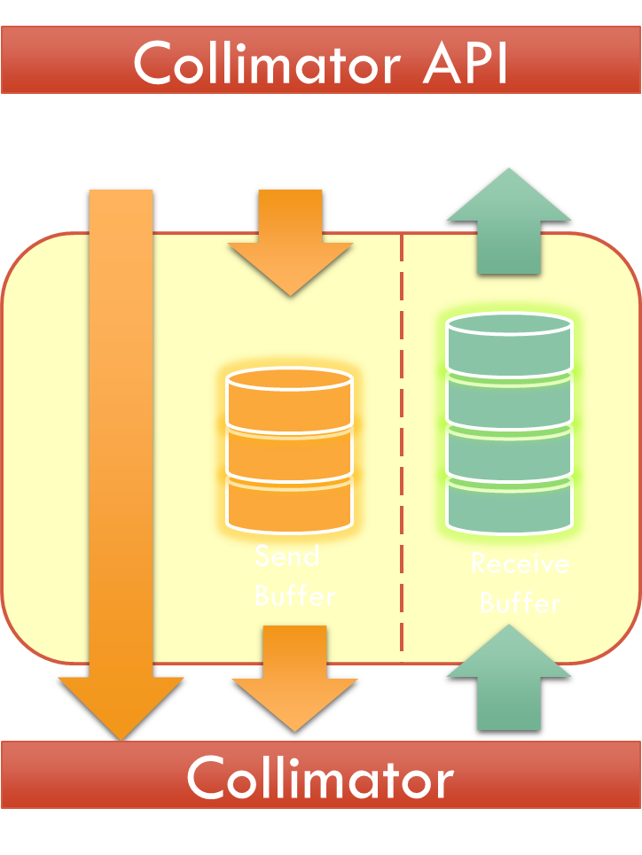

Insight xPost

Slide 20
Insight xPost engine
Generator
Actuator
Display
Workstation
Detector

Slide 21
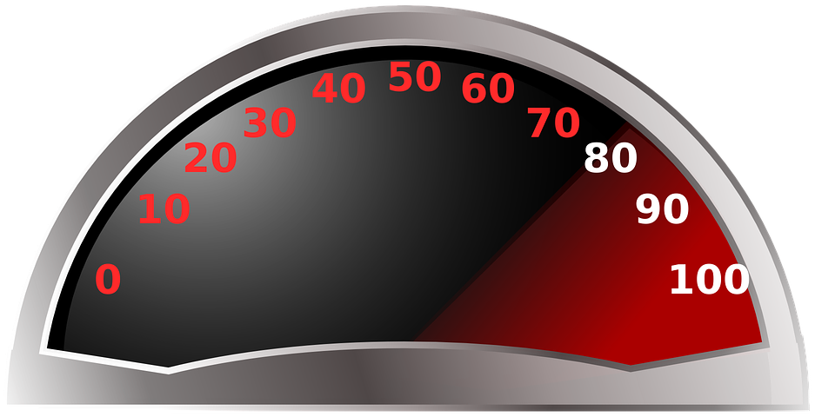
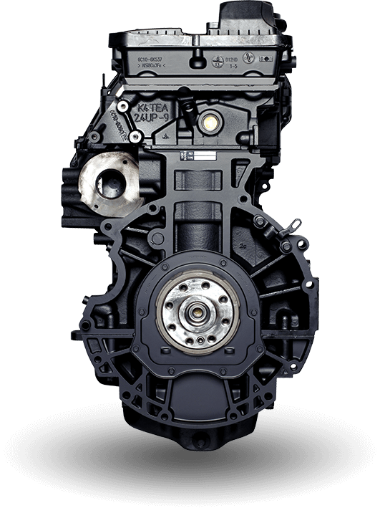
Insight xPost engine

Slide 22
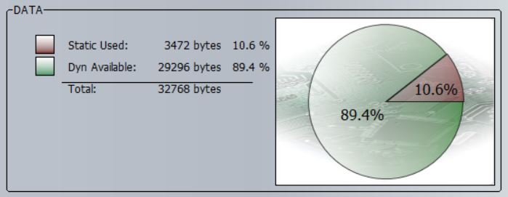
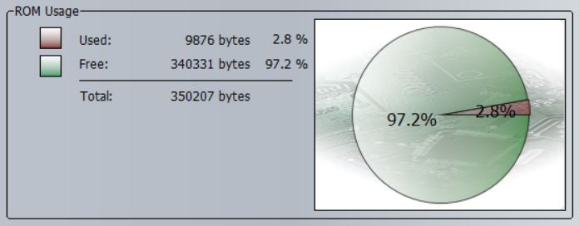
Xpost resource

